Slide 1


OBI Ann Arbor Workshop 2012:
Ontology Representation of Biostatistics Terms
Yongqun “Oliver” He
Unit for Laboratory Animal Medicine
Department of Microbiology and Immunology
Center for Computational Medicine and Bioinformatics
University of Michigan Medical School
Ann Arbor, MI 48109
Notes:
http://obi-ontology.org/page/Workshop_OBI_Vancouver_2010_Mar#Use_Case_.2B_Issues_Proposals

Slide 2
Advantages of Ontology-based Statistical Analyses
Allow data consistency checking
  e.g., RB51 is a Brucella vaccine
  BCG is a TB vaccine but not a Brucella vaccine
Data sharing in Semantic Web
Advanced data analysis in Semantic Web
Automated reasoning

Slide 3
Ontological Representation of Statistical Analyses
OntoDM:
  Ontological representation of data mining tasks and complex data types.
  Align with OBI
  http://kt.ijs.si/panovp/doku.php?id=ontodm
OBI statistical analysis:
  Provide general top structure
  Continuous efforts towards more details and deeper hierarchy

Slide 4
Measures of Central Tendency
(arithmetic) mean:
  Def. = the sum of the values divided by the number of values. Or: arithmetic average of a set of values, or distribution.
  WEB: http://en.wikipedia.org/wiki/Mean
  Done in OBI: ‘average value’ OBI_0000679
medium:
  Def. = the numerical value separating the higher half of a sample, a population, or a probability distribution, from the lower half.
  Done in OBI: ‘center value’ OBI_0000674
Suggestion: may add mean and medium as alternative terms to existing OBI terms.

Slide 5
Measures of Dispersion (1)
Dispersion refers to the degree to which data are scattered around a specific value (e.g., mean)
Standard deviation: measures the variability of data around the mean. It provides information on how much variability can be expected among individuals within a population. In samples that follow a "normal" distribution (i.e., Gaussian), 68 and 95 percent of values fall within one and two standard deviations of the mean, respectively.
  Not in OBI yet. OBI has ‘standard deviation calculation’ OBI_0200121, which has_specified_output only 'data item'
Standard error of the mean: describes how much variability can be expected when measuring the mean from several different samples.
  In OBI: OBI_0000235. Status: “pending final vetting”.

Slide 6
Measures of Dispersion (2)
Range: equals the difference between the largest and smallest observation.
  Not in OBI
Percentile: equals the percentage of a distribution that is below a specific value. As an example, a child is in 90th percentile for weight if only 10 percent of children the same age weigh more than she does.
  Not in OBI
Interquartile range: refers to the upper and lower values defining the central 50 percent of observations. The boundaries are equal to the 25th and 75th percentiles. The interquartile range can be depicted in a box and whiskers plot
  Not in OBI. OBI has ‘interquartile-range calculation’ OBI_0200122

Slide 7
Terms Describing Event Frequency
Incidence: the number of new events that have occurred in a specific time interval divided by the population at risk at the beginning of the time interval. The result gives the likelihood of developing an event in that time interval.
Prevalence: the number of individuals with a given disease at a given point in time divided by the population at risk at that point in time.
  Point prevalence: the proportion of individuals with a condition at a specified point in time,
  Period prevalence: the proportion of individuals with a condition during a specified interval (e.g., a year).
Both terms not in OBI yet.

Slide 8
Terms Describing Magnitude of an Effect
Used to define the relationship among variables of interest in a data set.
Relative risk (or risk ratio): equals the incidence in exposed individuals divided by the incidence in unexposed individuals. The relative risk can be calculated from studies in which the proportion of patients exposed and unexposed to a risk is known, such as a cohort study.
  Not in OBI yet
Odds ratio: the odds that an individual with a specific condition has been exposed to a risk factor divided by the odds that a control has been exposed. The odds ratio is used in case-control studies. The odds ratio provides a reasonable estimate of the relative risk for uncommon conditions.
  Not in OBI yet

Slide 9
Terms Describing Quality of Measurements
Reliability: the extent to which repeated measurements of a relatively stable phenomenon fall closely to each other.
Validity: the extent to which an observation reflects the "truth" of the phenomenon being measured.
Both terms not in OBI yet

Slide 10
Measures of Test Performance (1)
Sensitivity: The number of patients with a positive test who have a disease divided by all patients who have the disease. A test with high sensitivity will not miss many patients who have the disease (i.e., few false negative results).
Specificity: The number of patients who have a negative test and do not have the disease divided by the number of patients who do not have the disease. A test with high specificity will infrequently identify patients as having a disease when they do not (i.e., few false positive results).
Both terms not in OBI yet

Slide 11
Measures of Test Performance (2)
Likelihood ratio: a measure of the odds of having a disease relative to the prior probability of the disease. The estimate is independent of the disease prevalence.
  A positive likelihood ratio is calculated by dividing sensitivity by 1 minus specificity (sensitivity/(1-specificity)).
  A negative likelihood ratio is calculated by dividing 1 minus sensitivity by specificity ((1-sensitivity)/specificity).
  E.g., positive and negative likelihood ratios of 9 and 0.25, means that a positive result is seen 9 times as frequently while a negative test is seen 0.25 times as frequently in those with a specific condition than those without it.
  Not in OBI yet. OBI term ‘Likelihood-ratio test’ OBI_0000861
Accuracy: the number of true positives and true negatives divided by the total number of observations.
  Not in OBI yet.

Slide 12
Used in Making Inferences about Data (1)
Errors: Two potential errors are commonly recognized when testing a hypothesis.
Type I error (also known as alpha): the probability of incorrectly concluding that there is a statistically significant difference in a dataset. Alpha is the number after a p-value. Thus, a statistically significant difference reported as p<0.05 means that there is less than a 5 percent chance that the difference could have occurred by chance.
  Not in OBI yet
Type II error (also known as beta): the probability of incorrectly concluding that there was no statistically significant difference in a dataset. This error often reflects insufficient power of the study.
  Not in OBI yet

Slide 13
Used in Making Inferences about Data (2)
Confidence interval: The boundaries of a confidence interval give values within which there is a high probability (95 percent by convention) that the true population value can be found. The calculation of a confidence interval considers the standard deviation of the data and the number of observations. Thus, a confidence interval narrows as the number of observations increases, or its variance (dispersion) decreases.
  Not in OBI yet
Power (calculated as 1 - beta): the ability of a study to detect a true difference. Negative findings may reflect that the study was underpowered to detect a difference.
  A "power calculation“: to be sure that there are a sufficient number of observations to detect a desired degree of difference. The larger the difference, the fewer the number of observations required.
  Not in OBI yet

Slide 14
Study Design
Cohort study: starts with an exposure and moves forward to the outcome of interest, even if the data are collected retrospectively. As an example, a group of patients who have variable exposure to a risk factor of interest can be followed over time for an outcome.
Case-control study: starts with the outcome of interest and works backward to the exposure. For instance, patients with a disease are identified and compared with controls for exposure to a risk factor.
Randomized controlled trial (RCT): an experimental design in which patients are randomly assigned to two or more interventions.
These terms not in OBI yet.

Slide 15
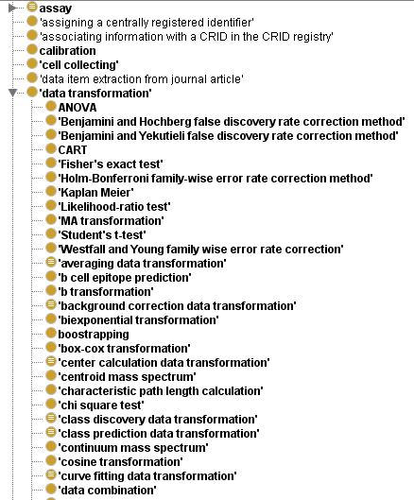
Many statistics tests already represented
in OBI
The output data items are often not specific, e.g., standard deviation, likelihood ratio
Different types of ANOVA missing

Slide 16
OBI Representation of ANOVA
Reference: OBI SIG 2010 paper
He Y, Xiang Z, Todd T, Courtot M, Brinkman R, Zheng J, Stoeckert CJ, Malone J, Rocca-Serra P, Sansone S, Fostel J, Soldatova LN, Peters B, Rutternberg A. Ontology representation and ANOVA analysis of vaccine protection investigation. Proceeding of Bio-Ontologies 2010: Semantic Applications in Life Sciences, ISMB, July 9-10, 2010. Boston, MA, USA. Full length paper.
Links:
https://obi.svn.sourceforge.net/svnroot/obi/trunk/docs/papers/SIG_2010/ANOVA_Vaccine_usecase_camera.pdf
https://obi.svn.sourceforge.net/svnroot/obi/trunk/docs/presentations/ANOVA_Vaccine_He_SIG2010.ppt

Slide 17
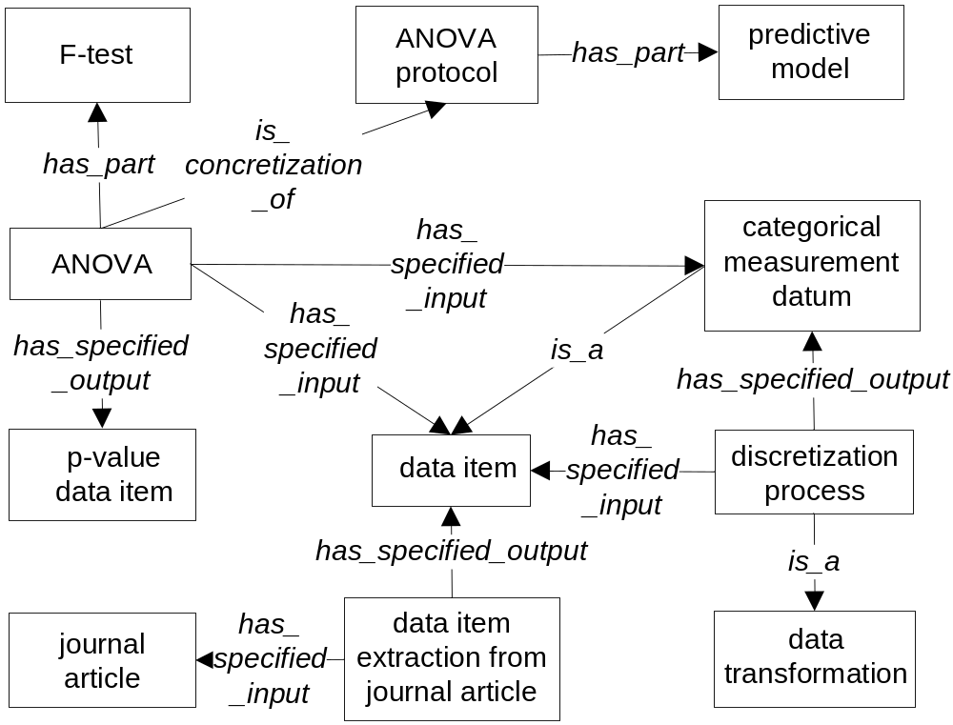
Ontology Design Pattern of ANOVA

Slide 18
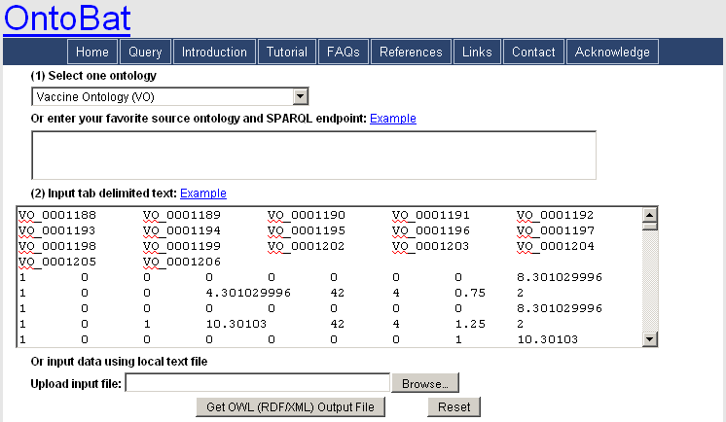
Transfer Instance Data to OWL
Instance data in correct VO ontology hierarchy
Only related ontology terms are included
Ontobat: http://ontobat.hegroup.org/

Slide 19
Challenges
How to represent statistical null hypothesis?
How to run ontology-supported statistical analysis within the context of semantic web?

Slide 20
More References
http://www.uptodate.com/contents/glossary-of-common-biostatistical-and-epidemiological-terms
http://dorakmt.tripod.com/mtd/glosstat.html
http://www.uth.tmc.edu/uth_orgs/educ_dev/oser/LGLOS1_0.HTM

Slide 21
Acknowledgements
OBI, IAO
NIH-NIAID Grant: R01AI081062

